Slide 1






A deep learning-based approach for accurate prediction of protein ubiquitination sites using word embedding techniques
Nov 15, 2022
Department of Information and Communication Technology
Mawlana Bhashani Science and Technology University
Santosh, Tangail-1902, Bangladesh

Slide 2


Introduce Ourselves
Presented By
Supervised By
Md. Faruk Hosen
ID: IT-17035
Department of ICT, MBSTU
Dr. Muhammad Shahin Uddin
Professor
Department of ICT, MBSTU
1

Slide 3
Outlines
Introduction
Objectives & Motivation
Related Works
Experimental Results
Methodology
Conclusion
References
2
Presented By- ID: IT-17035

Slide 4

Introduction
Ubiquitination is the biochemical process while ubiquitin protein is covalently linked it to lysine residue off target proteins [1].
Ubiquitination is responsible for many aspects of cellular molecular function, such as protein localization, metabolism, regulation and degradation [2-4].
It also participates in the regulation of various biological processes such as cell division and apoptosis, signal transduction, gene transcription, DNA repair and replication, intracellular transport and virus budding [2, 3].
Experimental and clinical studies have shown that abnormal ubiquitination status is involved in many diseases.
Due to the roles of ubiquitination, the precise prediction of ubiquitination sites is particularly important.
3
Presented By- ID: IT-17035

Slide 5
Introduction Cont..
Traditionally, researchers identify protein ubiquitination sites through wet-lab experimental techniques, but they are cost-intensive and time consuming.
So, it is an urgent need to develop a cost-effective prediction methods for accurately and rapidly identifying protein ubiquitination sites using machine learning.
4
Presented By- ID: IT-17035

Slide 6
Objectives
To develop a novel predictor for protein ubiquitination sites prediction.
We use machine learning and deep learning methods which will provide a strong identification of protein ubiquitination sites.
To increase the performance of existing method.
Also, try to apply different feature selection methods because feature selection increases the predictive power of machine learning algorithms.
Finally, the best features are provided to the CNN classifier for identifying protein ubiquitination sites.
5
Presented By- ID: IT-17035

Slide 7
Motivation
Ubiquitination occurs on those proteins which are misfolded or toxic proteins or on those proteins which are of no use in the cell.
Ubiuitination also happens to be part of some signaling pathways in order to switch on and switch off the pathways by the destruction of proteins so we say ubiquitination tags the protein for degradation.
Therefore, ubiquitination is a major field of bioinformatics research in recent years and becomes a new target for research and development of drugs.
So it is important to identify which is a protein ubiquitination site or which is not a protein ubiquitination site.
6
Presented By- ID: IT-17035

Slide 8
Related Works
UbiSite-XGBoost [5]
Limitations
Six datasets were collected from different databases and literatures.
Seven single-view features, i.e. PseAAC, CKSAAP, ANBPB, AAIndex, EBGW, BLOSUM62 and PsePSSM are used to extract features.
Applied Lasso for feature selection and then XGBoost classifier is used to predict Ubiquitination sites.
They use traditional machine learning method to predict protein ubiquitination sites.
They are not doing any parameter tuning in their machine learning method.
7
Presented By- ID: IT-17035

Slide 9
Related Works Cont..
DeepUbi [1]
Limitations
Accomplished analysis among six datasets.
Four feature encoding schemes, i.e. One-Hot encoding, IPCP, CKSAAP, and PseAAC are used to represent protein sequence patterns.
Applied CNN classifier to predict protein ubiquitination sites.
They don’t use any feature selection method.
The accuracy is 77.38%, 68.98%, 75.33%, 75.76%, 88.87% and 66.84% for set1-set6 datasets respectively, which is not so good. So there still has room for optimization.
8
Presented By- ID: IT-17035

Slide 10
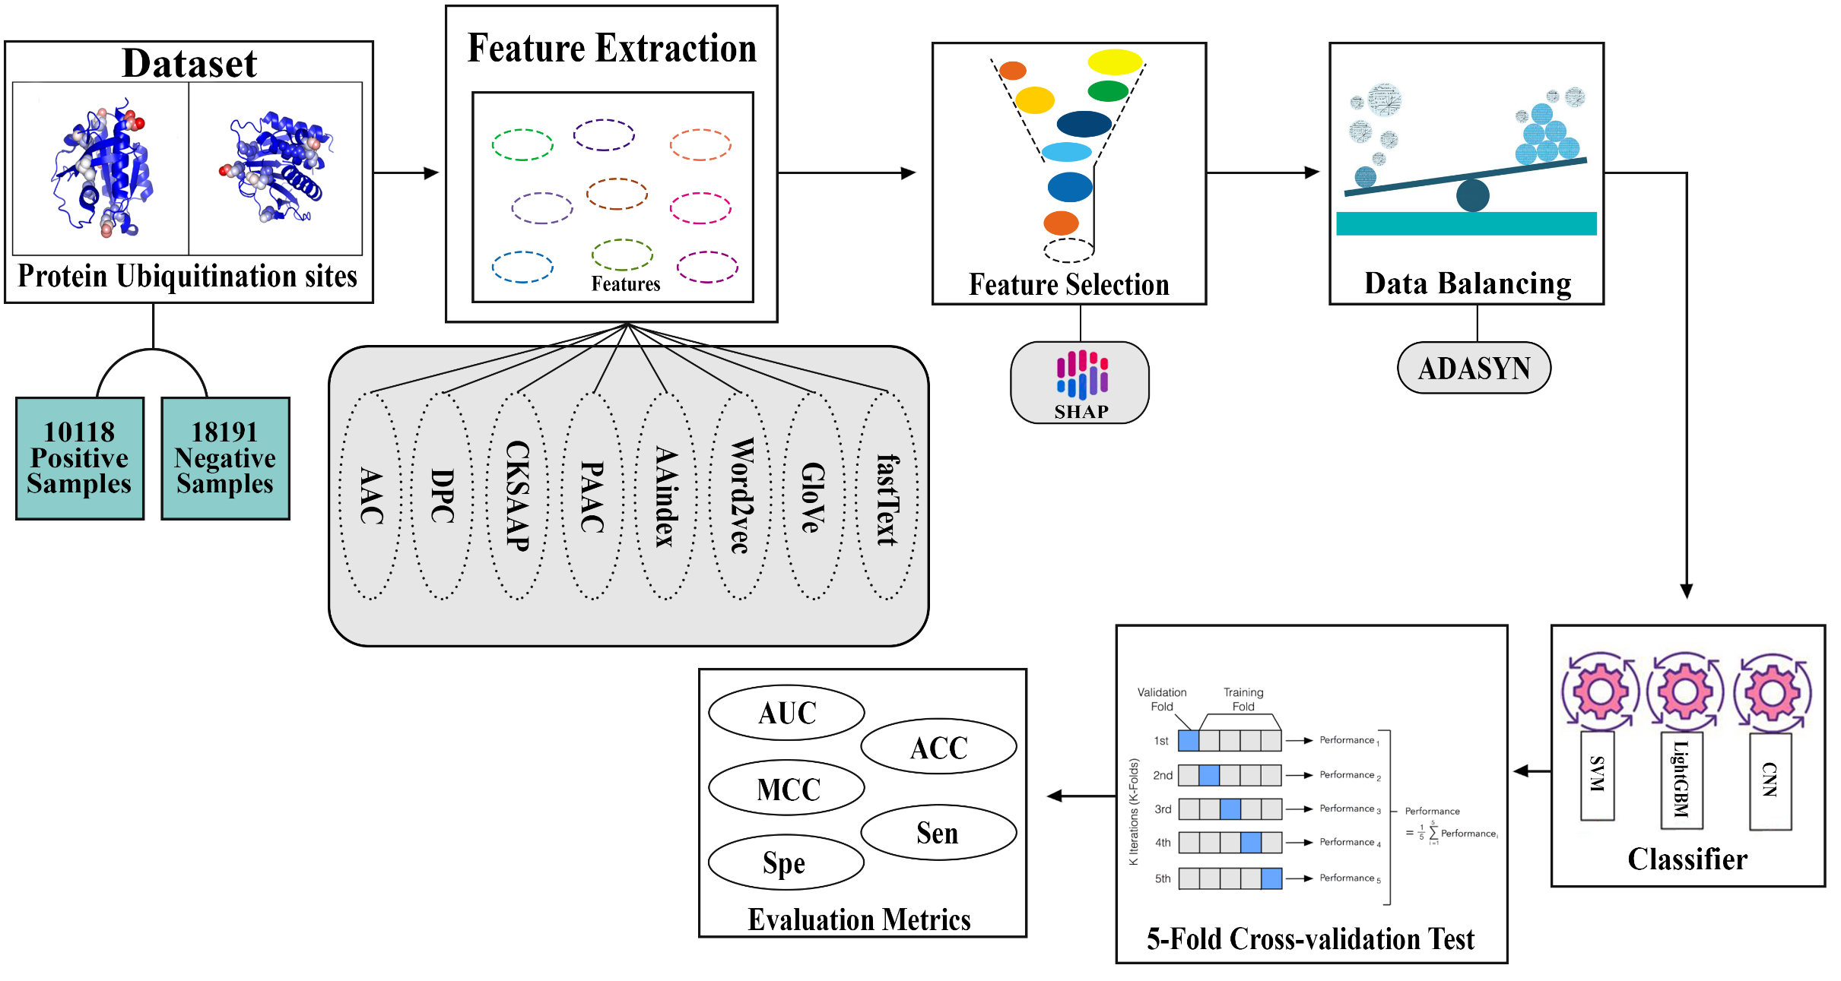
Methodology
9
Presented By- ID: IT-17035

Slide 11
Methodology Cont..
First of all we perform eight feature extraction methods, namely AAC, DPC, CKSAAP, PAAC, AAIndex, Word2vec, GloVe and fastText to represent the protein sequence patterns..
Secondly, SHapley Additive exPlanations (SHAP) is employed to remove the redundant and irrelevant features for predicting protein ubiquitination sites.
Thirdly, Adaptive synthetic sampling approach (ADASYN) is applied for the imbalanced datasets set4-set6.
Finally, best features are provided to the different machine learning and deep learning algorithms for identifying protein ubiquitination sites.
10
Presented By- ID: IT-17035

Slide 12
Experimental Results
Table 1: Comparison of AUC values of our proposed method with existing methods
 | Set1 | Set2 | Set3 | Set4 | Set5 | Set6
NB | 0.5289 | 0.5330 | 0.5141 | 0.6036 | 0.5505 | 0.5134
EBMC | 0.6714 | 0.6467 | 0.6667 | 0.6646 | 0.6373 | 0.6001
LR | 0.7244 | 0.6410 | 0.6476 | 0.7200 | 0.7235 | 0.5546
LASSO | 0.6933 | 0.6041 | 0.6129 | 0.5000 | 0.5000 | 0.5000
SVM | 0.6597 | 0.6035 | 0.6102 | 0.6670 | 0.6763 | 0.5758
DeepUbi | 0.7738 | 0.6898 | 0.7533 | 0.7576 | 0.8887 | 0.6684
UbiSite-XGBoost | 0.8258 | 0.7592 | 0.7853 | 0.9777 | 0.9782 | 0.9860
DeepWETUbi | 0.8846 | 0.7764 | 0.7881 | 0.9989 | 0.9983 | 0.9995
Methods
11
Presented By- ID: IT-17035

Slide 13
Conclusion
Accurate identification of protein ubiquitination site is essential for controlling substrate degradation and also understanding many biological processes. In this study, we have developed a new Ubiquitination site predictor, called DeepWETUbi.
Experimental results have shown that the DeepWETUbi significantly outperforms all other state-of-the-art methods.
The principle reason for the superior performances of DeepWETUbi is that our evolutionary based feature representation which provide more useful information to the CNNs-based protein Ubiquitination site identification model.
12
Presented By- ID: IT-17035

Slide 14
References
1
Fu, H., Yang, Y., Wang, X. et al. DeepUbi: a deep learning framework for prediction of ubiquitination sites in proteins. BMC Bioinformatics 20, 86 (2019). doi: 10.1186/s12859-019-2677-9.
2
Herrmann J, Lerman LO, Lerman A. Ubiquitin and ubiquitin-like proteins in protein regulation. Circ Res. 2007;100(9):1276–91.
3
Welchman R, Gordon C, Mayer RJ. Ubiquitin and ubiquitin-like proteins as multifunctional signals. Nat Rev Mol Cell Biol. 2005;6(8):599–609.
4
Hurley JH, Sangho L, Gali P. Ubiquitin-binding domains. Biochem J. 2006; 399(Pt 3):361.
5
Yushuang Liu and Shuping Jin, “ Prediction of protein ubiquitination sites via multi-view features based on eXtreme gradient boosting classifier”, Journal of Molecular Graphics and Modelling; doi: 10.1016/j.jmgm.2021.107962.
13
Presented By- ID: IT-17035

Slide 15


Q/A
Any Question ?
14
Presented By- ID: IT-17035

Slide 16
Thank You
15
Presented By- ID: IT-17035

